Slide 1
Decoding Dyslexia Round Table
IDEA & Reading
Round Table Leader
Tracey Morgan
Decoding Dyslexia Massachusetts
A Bright IDEA Advocates
tracey@abrightideaadvocates.com
This content is the property of NJD Educational Consultants – All Rights Reserved
This is informational and it is not legal advice.
Notes:
An IEP is both a legal document and a plan for instruction for students with disabilities, including dyslexia. This session explains to parents and educators the importance of knowing the terms and criteria of IDEA law. What to look for and what to exclude from current performance levels, objectives, and goals for students who need specialized reading instruction. The presentation is a practical guide to planning IEP goals in the context of the essential components of reading instruction and decisions for services based on scientifically based reading research. An overview of the important terms specific to reading in special education law is reviewed.

Slide 2
This kit targets planning for reading goals.
….. But reading is a complex process.
Can parents know what is important?
How will you impact the team's decisions?
Notes:
How does a parent or advocate recognize the important information needed for the complex process of teaching reading to a student with an IEP?
What can help direct the team and the IEP to follow the scientific evidence and make decisions that are responsive to the needs of the student and based on proven methods?
We will spend just a few minutes on the complex process of reading and more time on how you can wade through the complexity with good references.

Slide 3
2 things you will take away with this kit and conversation.
Direction
to get you going in the right direction
Decision-Making Tools
Resources for individualizing the plan based on evidence.
Notes:
Although reading is a complex process, IDEA law provides significant direction that is often overlooked.
I am going to use the text or words written directly by Congress, about "reading " in IDEA and show you how to track this important guidance throughout this process. We are going to use this as a road map to reading.
But first, there are some basic established advocacy “groundwork” that I base the rest of this presentation on.

Slide 4



Parents and Advocates at the IEP Table
There is a “Road Map” for the complexity of reading on the IEP
….. And Congress provides it in the IDEA law.
Do you need to be an expert to know?
    Skills for Reading –
    Peer-reviewed evidence-based intervention
    Fidelity to peer-reviewed evidence-based intervention
    Frequency and duration on the service grid
Notes:
Is there a road map to help parents and advocates with this complex process and our complex kids?
So many questions … reading skills, peer-reviewed evidence-based interventions, .. What if Congress has provided some direction in the law of IDEA?

Slide 5
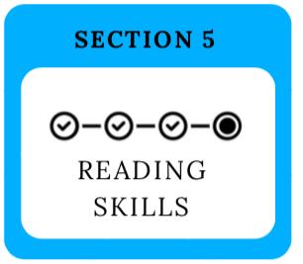
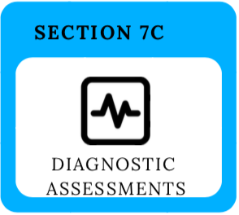
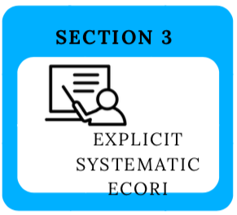
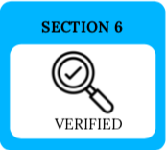
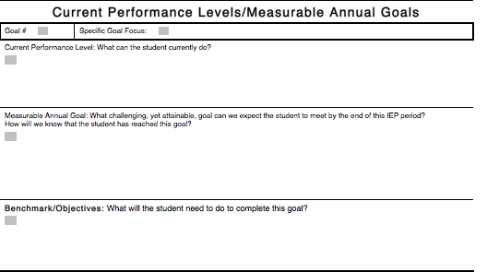
Congress provided direction!
Congress defined Reading!
The skills listed should be the skills taught and measured on the IEP
Congress defined Diagnostic Reading Assessments: the standard for measuring reading skills when making IEP decisions!
Congress defined the Essential Components of Reading Instruction (ECORI) and this is the instruction for the skills needed in a reading goal!
Congress defined Scientifically Based Reading Research. SBRR should be used to choose programs, methods, and training that are specialized, and implemented with fidelity. Verify with SBRR
Learn to use the defined terms in
U.S.C. 6368 (3)(4)(5)(6)(7)
to advocate and write effective IEP goals.
Notes:
Start by looking at Reading Goals 1 handout. Notice the icons that I created to guide you and remind you that each section of the defined terms provided by Congress has an important role to guide you. Let’s look at the defined terms starting with section 5, because this is the IDEA Congressional definition of reading. Then section 7c defines diagnostic reading assessments, section 3 is the very important definition of the essential components of reading instruction and section 6 is scientifically based reading research.

Slide 6
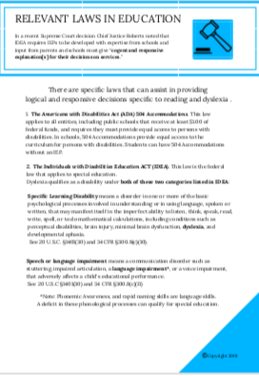
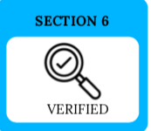
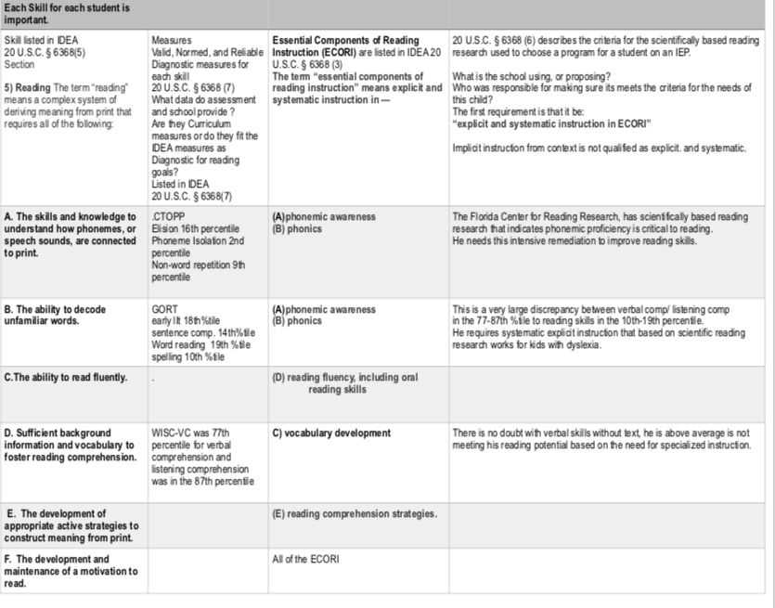
Use the law to ensure an IEP is reasonably calculated for grade level reading proficiency?
Check the reading skills
Provide ECORI based on verified evidence.
Assess reading with valid diagnostic measures
Notes:
Refer to the handout.
Mention that some states provide Handbooks and Guidance

Slide 7
☐ Is the proposed instruction explicit?
☐ Is the proposed instruction systematic?
☐ Is it truly instruction or practice?
☐ Is there a measure or monitoring tool in the classroom for this instruction? (7D)
☐ What corresponding reliable valid diagnostic reading assessment assesses the targeted skill(s) for goal decision making? (7C)
☐ What SBRR has been referenced to prove that the methods meet the standards of SBRR in Section 6 including frequency and duration.
Notes:
Reference

Slide 8
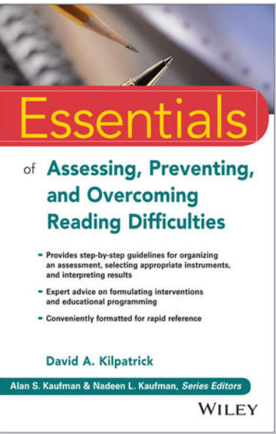
What do you need?
You should have handouts
IEP Goals #1
IEP Goals #2
IEP Goals #3
and I recommend purchasing:
The Essentials of Assessing and
Preventing Reading Difficulties,
by David Kilpatrick
Notes:
We have already pointed out the first handout, the Deheane paper,– but the other handouts will be used to guide you and I highly recommend this book by David Kilpatrick that I use regularly. Certainly, there are lots of other examples of research but these are the tools I use in my work and with this presentation.

